Slide 1
Knowles Athletico
Very Interesting
Little Interesting
Not Interesting
 | Use-cases | Athletico Functionality | AP
1 | Always On : OK Google detection | OK Google-first stage detection OK Google detection during Media record mode Echo canceller for Barge-in | Additional stages on SD855 after Athletico front end, low power processing
2 | Always On : Ambient music detection (100%) | Local detection for song/artist Ambient music detection even during media record Echo canceller during music playback | Other stages on SDM855
3 | Motion Sense detection Face unlock (100%) | Radar sensor detects the face near the phone for fastest face unlock in industry : privacy to have all this on phone only Flicker sensor data pass through, enabling the face unlock camera/ToF measurements on the system | AP runs Face Unlock, but Radar Sensor on Athletico
4 | Motion Sense Presence: Alarm clock, Poser screen on/off, and more (100%) | Radar Sensor detects user is near the device I.e hand reach towards phone, or walking away from the phone, can turn on/off the screen. All processed on Athletico | AP decides what to do with Athletico Radar Sensor information of scenario. Alarm goes softer as your hand nears the phone. Walking away from phone turns off screen.
5 | Motion Sense Gesture: Music Track Swipe forward (100%) | Radar Sensor Running on Athletico detects swipes to skip songs, shut off alarm, interact w games. Smart enough to reject coffee mug passing over top of phone (similar to swipe) vs hand swipe motion | AP will combine Gesture with Apps, gaming
6 | Battery Saver | Athletico provides power data from its use cases upwards to the system to optimize | SDM855 takes power data across system for optimization

Slide 2
Knowles Athletico
 | Use-cases | Athletico Functionality | AP
7 | Camera App – Filcker sensor detect | flicker Sensor is connected to Athletico, pass-through data to SoC | SDM855 processes Filcker data
8 | Network Voice call | Athletico passes Audio use cases with low latency – for all carriers | NS resides on SDM855
9 | VoIP Call – DUO, hangouts, Skype, etc | Athletico passes Audio use cases with low latency – for all carriers | NS resides on SDM855
10 | Media Recording : Sound recorder, Media recording (camera) | Athletico used for passing Audio OK google support during media record | Other stages on SDM855
11 | Context Awareness : Car mode | Athletico buffers audio and passes to SLPI for CHRE to detect its in Car Mode. This allows for Google Assistant to provide quick message replies to incoming calls “I’m driving – call you later” | Other stages on SMD855, SLPI
12 | Context Awareness : Car Crash Detection | Athletico buffers audio and passes to SLPI for CHRE to detect its in a crash | Other stages on SMD855, SLPI
13 | Live transcription YouTube, Record (On deice) | Athletico used for passing audio | Other stages on SDM855
14 | Next Gen Google Assistant : No need to say OK Google | Athletico used for passing audio, and Radar Sensor running on Athletico enables use cases without the hotword phrase. Ex) when it knows it’s the user (Face ID), or in a string of commands | Other stages on SDM855

Slide 3
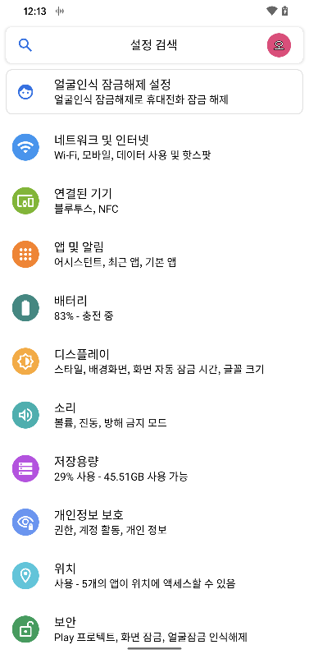
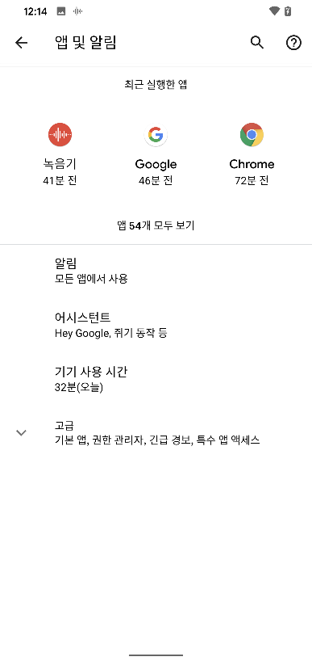
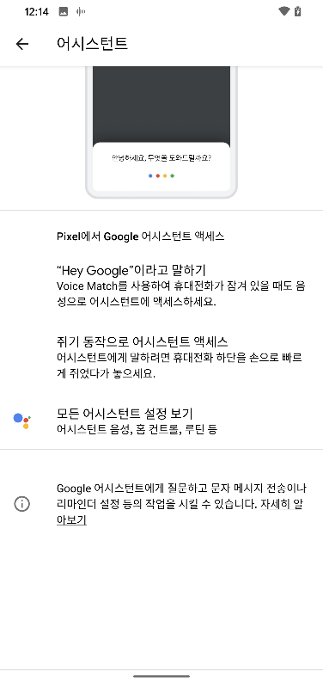
1 | Always On : OK Google detection | OK Google-first stage detection OK Google detection during Media record mode Echo canceller for Barge-in
1. 호출명 확장 Ok google + Hey google

Slide 4
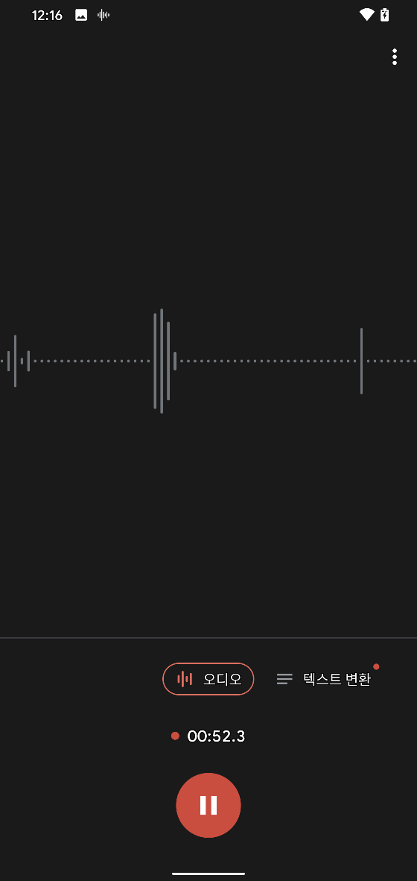
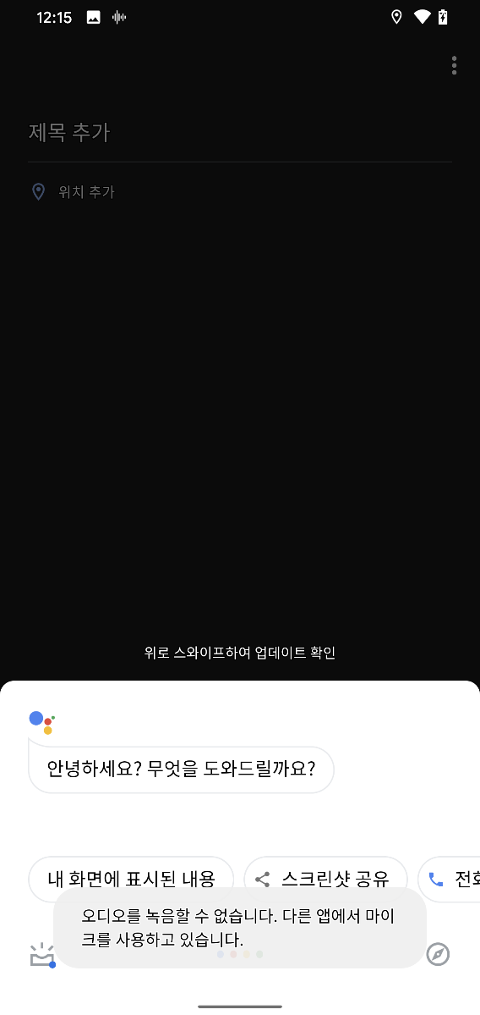
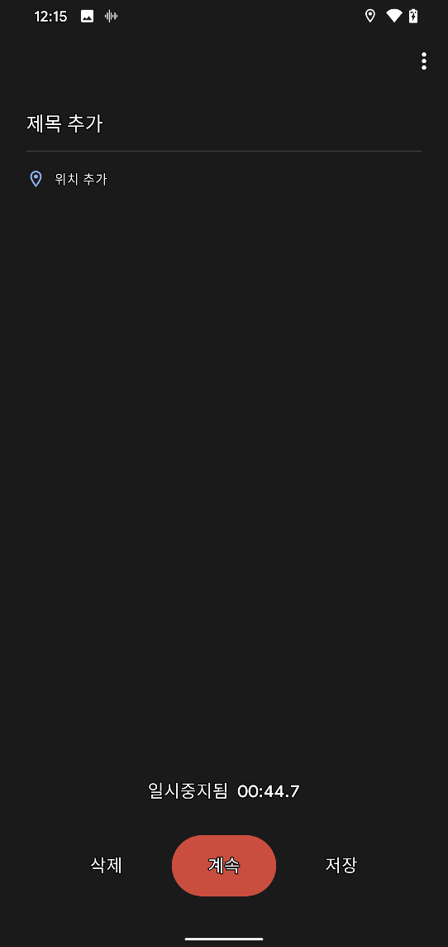
2. 레코딩 중 Barge-In 잘 동작함.
당사도 Playback중 Barge-In 동작은
지원하지만 레코딩중에는 지원하지
않음.

Slide 5
2 | Always On : Ambient music detection (100%) | Local detection for song/artist Ambient music detection even during media record Echo canceller during music playback

Slide 6
3 | Motion Sense detection Face unlock (100%) | Radar sensor detects the face near the phone for fastest face unlock in industry : privacy to have all this on phone only Flicker sensor data pass through, enabling the face unlock camera/ToF measurements on the system

Slide 7
4 | Motion Sense Presence: Alarm clock, Poser screen on/off, and more (100%) | Radar Sensor detects user is near the device I.e hand reach towards phone, or walking away from the phone, can turn on/off the screen. All processed on Athletico

Slide 8
5 | Motion Sense Gesture: Music Track Swipe forward (100%) | Radar Sensor Running on Athletico detects swipes to skip songs, shut off alarm, interact w games. Smart enough to reject coffee mug passing over top of phone (similar to swipe) vs hand swipe motion

Slide 9
6 | Battery Saver | Athletico provides power data from its use cases upwards to the system to optimize

Slide 10
7 | Camera App – Filcker sensor detect | flicker Sensor is connected to Athletico, pass-through data to SoC

Slide 11
8 | Network Voice call | Athletico passes Audio use cases with low latency – for all carriers

Slide 12
9 | VoIP Call – DUO, hangouts, Skype, etc | Athletico passes Audio use cases with low latency – for all carriers

Slide 13
10 | Media Recording : Sound recorder, Media recording (camera) | Athletico used for passing Audio OK google support during media record

Slide 14
11 | Context Awareness : Car mode | Athletico buffers audio and passes to SLPI for CHRE to detect its in Car Mode. This allows for Google Assistant to provide quick message replies to incoming calls “I’m driving – call you later”

Slide 15
12 | Context Awareness : Car Crash Detection | Athletico buffers audio and passes to SLPI for CHRE to detect its in a crash

Slide 16
13 | Live transcription YouTube, Record (On deice) | Athletico used for passing audio

Slide 17
14 | Next Gen Google Assistant : No need to say OK Google | Athletico used for passing audio, and Radar Sensor running on Athletico enables use cases without the hotword phrase. Ex) when it knows it’s the user (Face ID), or in a string of commands

