Slide 1
Knowles Athletico
내용 추가(구분)
Very Interesting
Little Interesting
Not Interesting
 | Use-cases | Athletico Functionality | AP
1 | Always On : OK Google detection | OK Google-first stage detection OK Google detection during Media record mode Echo canceller for Barge-in | Additional stages on SD855 after Athletico front end, low power processing
2 | Always On : Ambient music detection (100%) | Local detection for song/artist Ambient music detection even during media record Echo canceller during music playback On-device 인식 여부 확인 / music 과 배경 사운드 구별 가능 여부 | Other stages on SDM855
3 | Motion Sense detection Face unlock (100%) | Radar sensor detects the face near the phone for fastest face unlock in industry : privacy to have all this on phone only Flicker sensor data pass through, enabling the face unlock camera/ToF measurements on the system Face unlock / Alarm clock, screen on/off and more / Music track swipe Always on 기능인지. | AP runs Face Unlock, but Radar Sensor on Athletico
4 | Motion Sense Presence: Alarm clock, Poser screen on/off, and more (100%) | Radar Sensor detects user is near the device I.e hand reach towards phone, or walking away from the phone, can turn on/off the screen. All processed on Athletico | AP decides what to do with Athletico Radar Sensor information of scenario. Alarm goes softer as your hand nears the phone. Walking away from phone turns off screen.
5 | Motion Sense Gesture: Music Track Swipe forward (100%) | Radar Sensor Running on Athletico detects swipes to skip songs, shut off alarm, interact w games. Smart enough to reject coffee mug passing over top of phone (similar to swipe) vs hand swipe motion | AP will combine Gesture with Apps, gaming
6 | Battery Saver | Athletico provides power data from its use cases upwards to the system to optimize | SDM855 takes power data across system for optimization

Slide 2
Knowles Athletico
 | Use-cases | Athletico Functionality | AP
7 | Camera App – Filcker sensor detect | flicker Sensor is connected to Athletico, pass-through data to SoC | SDM855 processes Filcker data
8 | Network Voice call | Athletico passes Audio use cases with low latency – for all carriers | NS resides on SDM855
9 | VoIP Call – DUO, hangouts, Skype, etc | Athletico passes Audio use cases with low latency – for all carriers | NS resides on SDM855
10 | Media Recording : Sound recorder, Media recording (camera) | Athletico used for passing Audio OK google support during media record 레코더 동작시 audio scene 검출 현황 (음성/뮤직/박수/휘파람 외 다른 사운드 인식 여부) 레코더 음성인식(speech to text) 기능 확인 : 지원 언어, 잡음환경 동작, 동시 말할 때 인식 성능 등 | Other stages on SDM855
11 | Context Awareness : Car mode | Athletico buffers audio and passes to SLPI for CHRE to detect its in Car Mode. This allows for Google Assistant to provide quick message replies to incoming calls “I’m driving – call you later” 오디오 신호를 이용한 car mode 동작 여부 확인 Car mode 기능 시나리오 분석 (어떤 기능들이 있는지) | Other stages on SMD855, SLPI
12 | Context Awareness : Car Crash Detection | Athletico buffers audio and passes to SLPI for CHRE to detect its in a crash | Other stages on SMD855, SLPI
13 | Live transcription YouTube, Record (On deice) | Athletico used for passing audio 동영상 촬영 contents 에서의 번역 성능 확인 | Other stages on SDM855
14 | Next Gen Google Assistant : No need to say OK Google | Athletico used for passing audio, and Radar Sensor running on Athletico enables use cases without the hotword phrase. Ex) when it knows it’s the user (Face ID), or in a string of commands OK google 명령어 없이 음성 인식 가능 여부 Face ID 연동 외에 다른 시나리오에 Ok google 명령어 없이 음성 인식 되는지 확인 | Other stages on SDM855

Slide 3
1 | Always On : OK Google detection | OK Google-first stage detection OK Google detection during Media record mode Echo canceller for Barge-in
레코딩 도중 음성인식 가능 : Barge-in 기술은 일반적으로 스피커나 헤드폰과 같은 재생장치에서 재생 중
음성 명령을 처리하기 위한 기능으로 대부분 Playback중에만 적용을 하는 것이 일반적이나, Recording중
Barge-in을 적용한 첫? 사례로

Slide 4
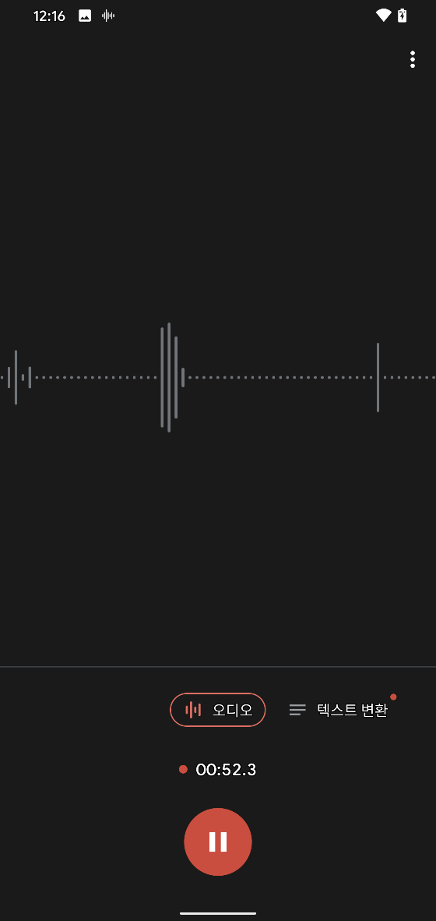
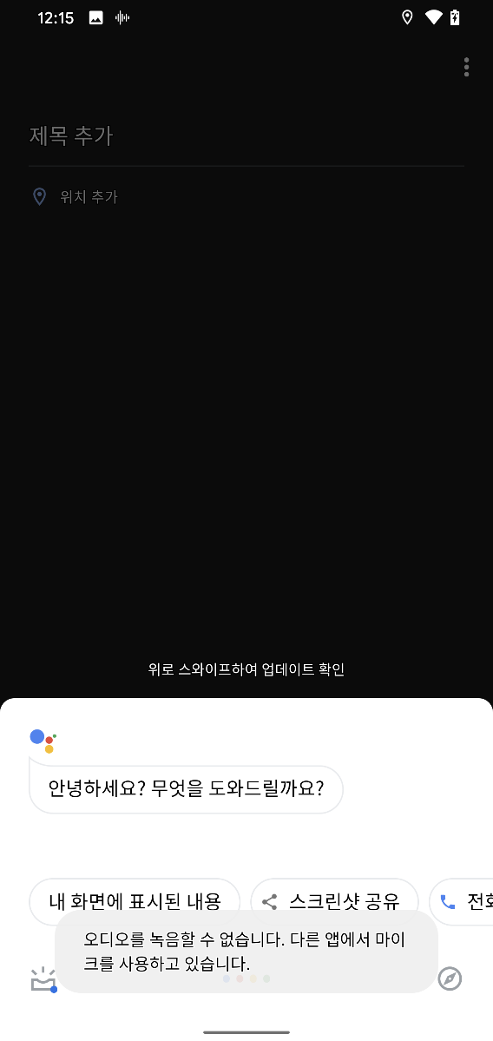
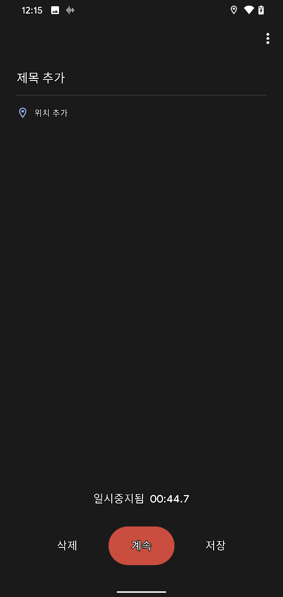
2. 레코딩 중 Barge-In 잘 동작함.
당사도 Playback중 Barge-In 동작은
지원하지만 레코딩중에는 지원하지
않음.

Slide 5
2 | Always On : Ambient music detection (100%) | Local detection for song/artist Ambient music detection even during media record Echo canceller during music playback On-device 인식 여부 확인 / music 과 배경 사운드 구별 가능 여부

Slide 6
3 | Motion Sense detection Face unlock (100%) | Radar sensor detects the face near the phone for fastest face unlock in industry : privacy to have all this on phone only Flicker sensor data pass through, enabling the face unlock camera/ToF measurements on the system Face unlock / Alarm clock, screen on/off and more / Music track swipe Always on 기능인지.

Slide 7
4 | Motion Sense Presence: Alarm clock, Poser screen on/off, and more (100%) | Radar Sensor detects user is near the device I.e hand reach towards phone, or walking away from the phone, can turn on/off the screen. All processed on Athletico

Slide 8
5 | Motion Sense Gesture: Music Track Swipe forward (100%) | Radar Sensor Running on Athletico detects swipes to skip songs, shut off alarm, interact w games. Smart enough to reject coffee mug passing over top of phone (similar to swipe) vs hand swipe motion

Slide 9
6 | Battery Saver | Athletico provides power data from its use cases upwards to the system to optimize

Slide 10
7 | Camera App – Filcker sensor detect | flicker Sensor is connected to Athletico, pass-through data to SoC

Slide 11
8 | Network Voice call | Athletico passes Audio use cases with low latency – for all carriers

Slide 12
9 | VoIP Call – DUO, hangouts, Skype, etc | Athletico passes Audio use cases with low latency – for all carriers

Slide 13
10 | Media Recording : Sound recorder, Media recording (camera) | Athletico used for passing Audio OK google support during media record 레코더 동작시 audio scene 검출 현황 (음성/뮤직/박수/휘파람 외 다른 사운드 인식 여부) 레코더 음성인식(speech to text) 기능 확인 : 지원 언어, 잡음환경 동작, 동시 말할 때 인식 성능 등

Slide 14
11 | Context Awareness : Car mode | Athletico buffers audio and passes to SLPI for CHRE to detect its in Car Mode. This allows for Google Assistant to provide quick message replies to incoming calls “I’m driving – call you later”

Slide 15
12 | Context Awareness : Car Crash Detection | Athletico buffers audio and passes to SLPI for CHRE to detect its in a crash

Slide 16
13 | Live transcription YouTube, Record (On deice) | Athletico used for passing audio 동영상 촬영 contents 에서의 번역 성능 확인

Slide 17
14 | Next Gen Google Assistant : No need to say OK Google | Athletico used for passing audio, and Radar Sensor running on Athletico enables use cases without the hotword phrase. Ex) when it knows it’s the user (Face ID), or in a string of commands OK google 명령어 없이 음성 인식 가능 여부 Face ID 연동 외에 다른 시나리오에 Ok google 명령어 없이 음성 인식 되는지 확인

